Slide 1
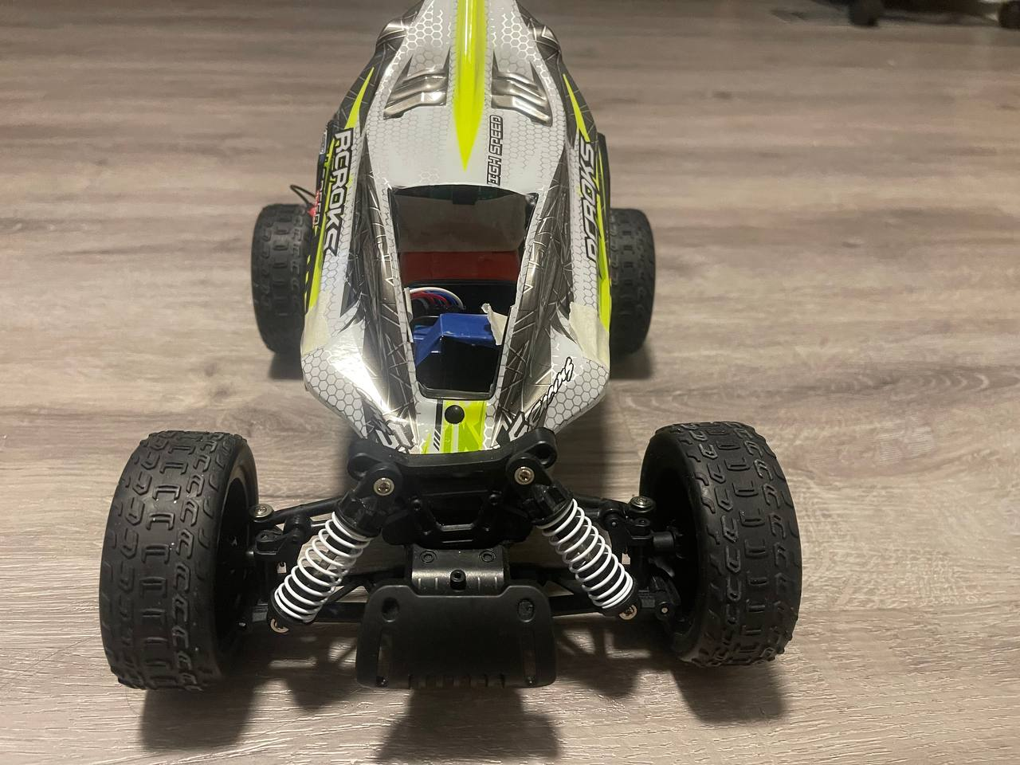
PiDriver
Abdumalik Shamurov
Email: ashamurov@myseneca.ca
Cell: 647-687-9588

Slide 2
PiDriver
PiDriver technical project, where we bring together the worlds of gaming and RC cars. PiDriver is a project that enables you to control an RC car using a gaming wheel and pedals, all through the power of a Raspberry Pi and a Flask web server.
The project combines cutting-edge technology with a passion for remote control car racing, creating an immersive experience for hobbyists and professionals alike. The Raspberry Pi serves as the brain of the project, controlling the RC car and communicating with the gaming wheel and pedals through the Flask web server.
With PiDriver, you can enjoy a more intuitive and immersive driving experience, taking control of your RC car like never before. The project is a testament to the power of innovation and creativity, and we are excited to share it with you.

Slide 3
PiDriver
PiDriver offers an innovative way to control an RC car by using a gaming wheel and pedals, all controlled through a Raspberry Pi and a Flask web server. The product offers an intuitive and immersive driving experience for hobbyists and professionals alike, allowing them to take control of their RC car like never before.
The Flask web server serves as a bridge between the gaming wheel and pedals and the Raspberry Pi, allowing for seamless communication and control. This means that users can use the gaming wheel and pedals to steer, accelerate, and brake the RC car, giving them a level of control that is simply not possible with traditional remote control methods.
PiDriver is also highly customizable, allowing users to modify and adapt the system to suit their needs. For example, users can adjust the sensitivity of the gaming wheel and pedals, as well as the speed and turning radius of the RC car. This makes PiDriver a versatile and adaptable product that can be tailored to the specific requirements of each user.
Overall, PiDriver offers an innovative, immersive, and customizable solution for controlling RC cars, enabling users to take their driving experience to the next level.

Slide 4
PiDriver – Technical Build
Hardware:
Raspberry Pi: Used as the main controller for the system, and runs the Flask web server.
Gaming wheel and pedals: Used to control the RC car.
L298N Dual H-Bridge Motor Controller: Used to control the RC car's motors.
RC car motors: Used to drive the RC car.
Raspberry Pi Camera : Used to capture live video feed from the RC car.
Software:
Operating system: An OS such as Raspbian is installed on the Raspberry Pi.
Flask web server: Used to control the RC car via a web interface.
Python libraries: Used to communicate with the gaming wheel and pedals, and the L298N motor controller.
GPIO pins: Configured to interface with the L298N motor controller and control the RC car's motors.

Slide 5
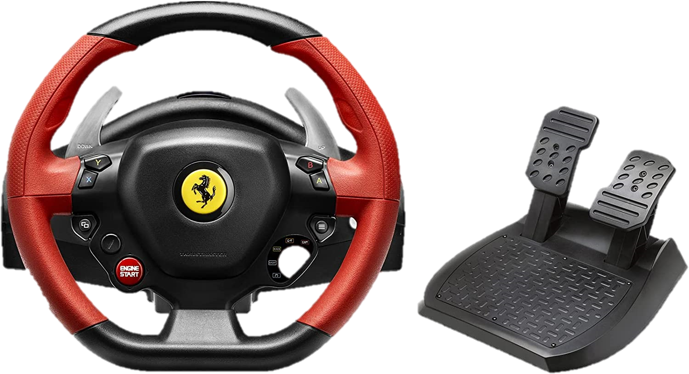
PiDriver – Key Elements
Gaming Wheel and Pedals - The gaming wheel and pedals are compatible with any PC game that supports gaming wheels and pedals. They have a USB interface and offer a realistic and immersive driving experience.

Slide 6
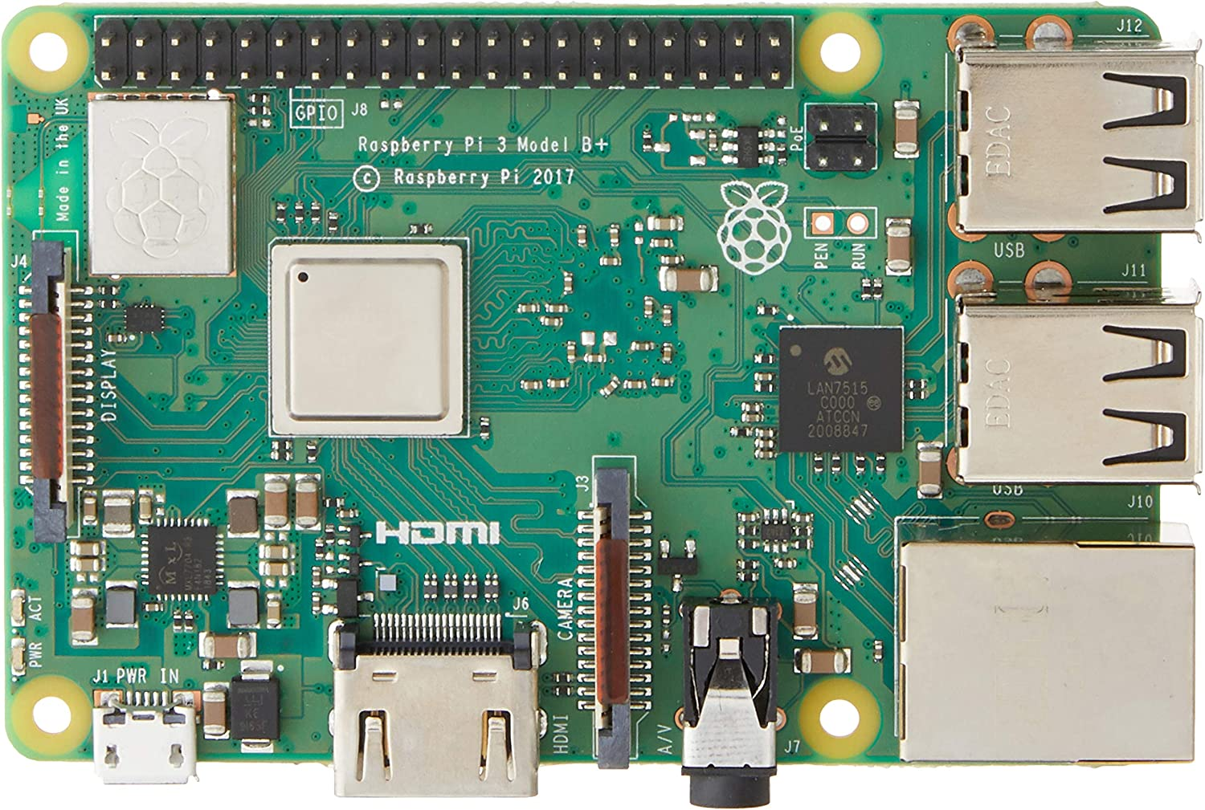
PiDriver – Key Elements
Raspberry Pi - The Raspberry Pi used in the PiDriver system is a Raspberry Pi 3 Model B or later, with a 1.2 GHz quad-core ARM Cortex-A53 CPU, 1GB RAM, and support for Bluetooth and Wi-Fi connectivity.

Slide 7

PiDriver – Key Elements
Flask Web Server - The Flask web server used in the PiDriver system is a lightweight web server written in Python. It can handle multiple requests at once and supports web sockets for real-time communication.

Slide 8
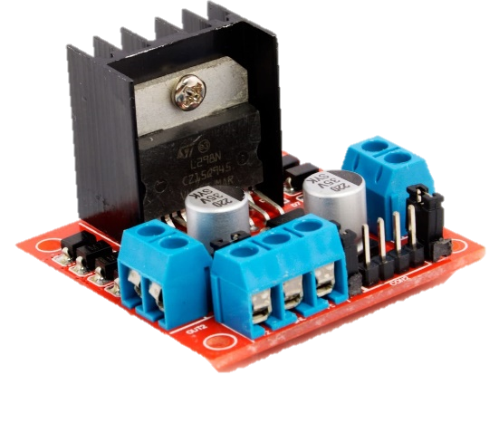
PiDriver – Key Elements
Motor Controller - The motor controller used in the PiDriver system is a L298N Dual H-Bridge Motor Controller, capable of controlling two DC motors with a maximum current of 2A per channel.

Slide 9
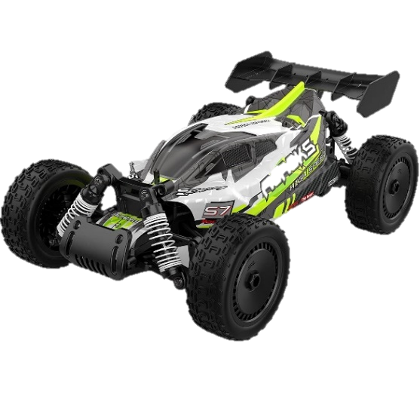
PiDriver – Key Elements
RC Car - The RC car used with the PiDriver system can be any RC car that is compatible with the motor controller and has enough space for the Raspberry Pi and other components. The system is designed to work with most standard RC cars.

Slide 10
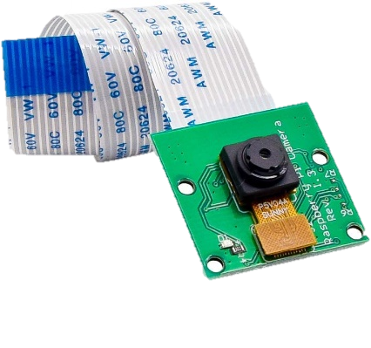
PiDriver – Key Elements
Raspberry Pi Camera - a small camera module that can be used with the PiDriver system to provide a live video feed of the RC car's perspective. It is capable of capturing 1080p video at 30 frames per second, and can also capture still images at up to 8 megapixels. The camera connects directly to the Raspberry Pi's camera port, and can be controlled using the PiCamera Python library.

Slide 11
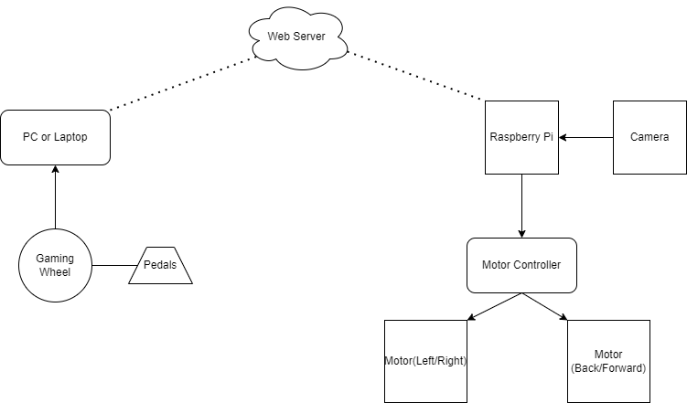
PiDriver – System Block Diagram
In this block diagram, the Gaming Wheel and Pedals provide input to the Raspberry Pi via a USB interface. The Raspberry Pi runs the Flask web server and uses GPIO pins to communicate with the L298N Dual H-Bridge Motor Controller. The motor controller receives commands from the Raspberry Pi and translates them into signals that control the RC car motors. The RC car motors are connected directly to the motor controller, and they provide the physical movement of the RC car.

Slide 12
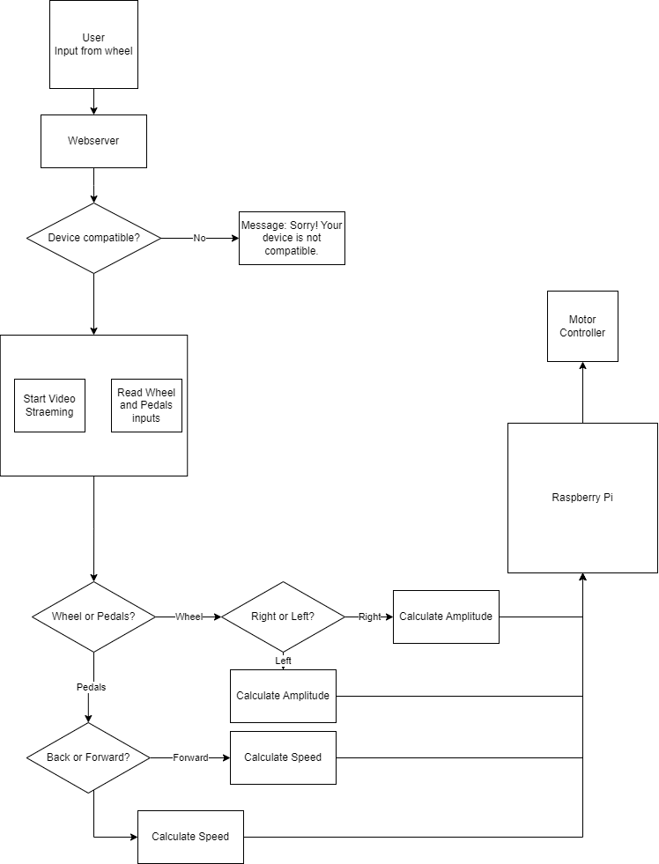
PiDriver – Software Diagram
In this software diagram, the Flask web server is the primary interface for the user to control the RC car via the gaming wheel and pedals. The Flask web server is written in Python and uses the PiDriver script to communicate with the Raspberry Pi's GPIO pins. The PiDriver script translates the input from the gaming wheel and pedals into GPIO signals that are sent to the L298N Dual H-Bridge Motor Driver. The motor driver then interprets the signals and controls the RC car motors accordingly.

Slide 13
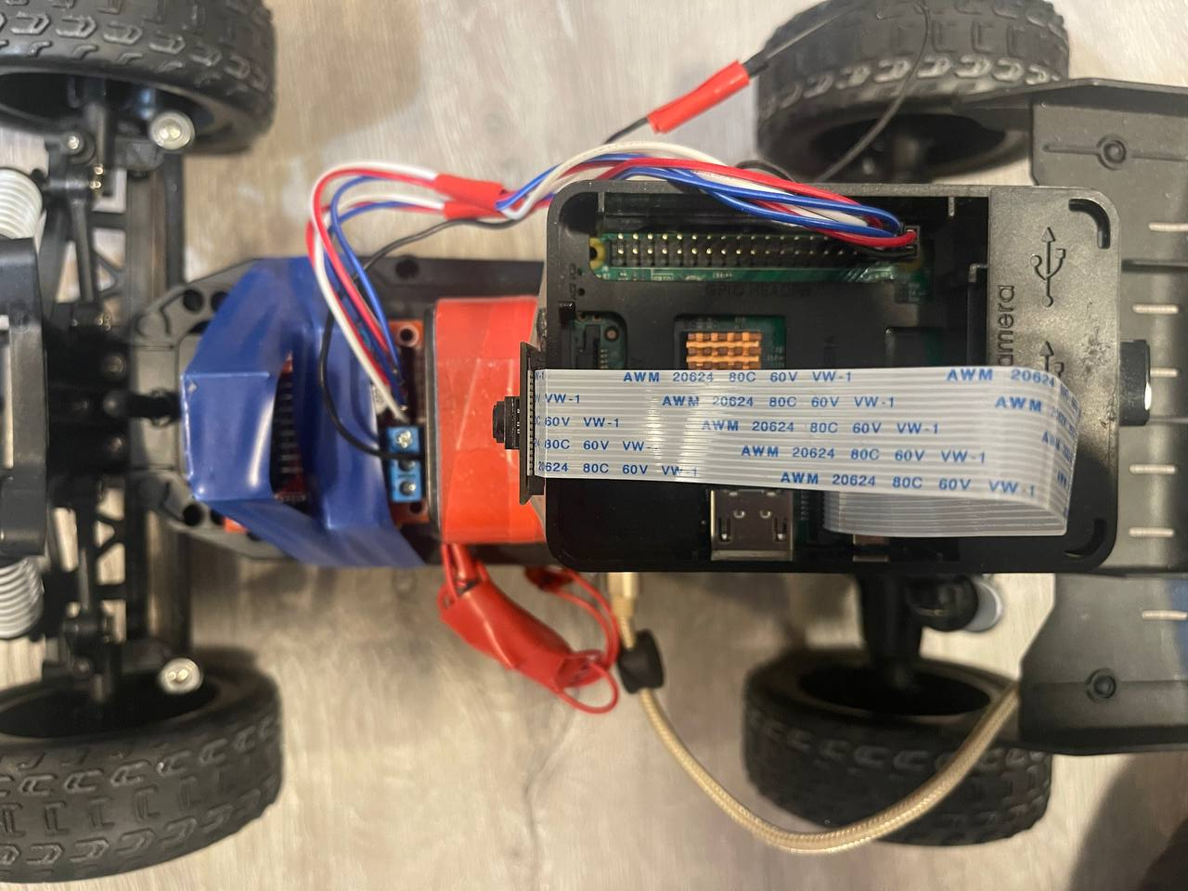
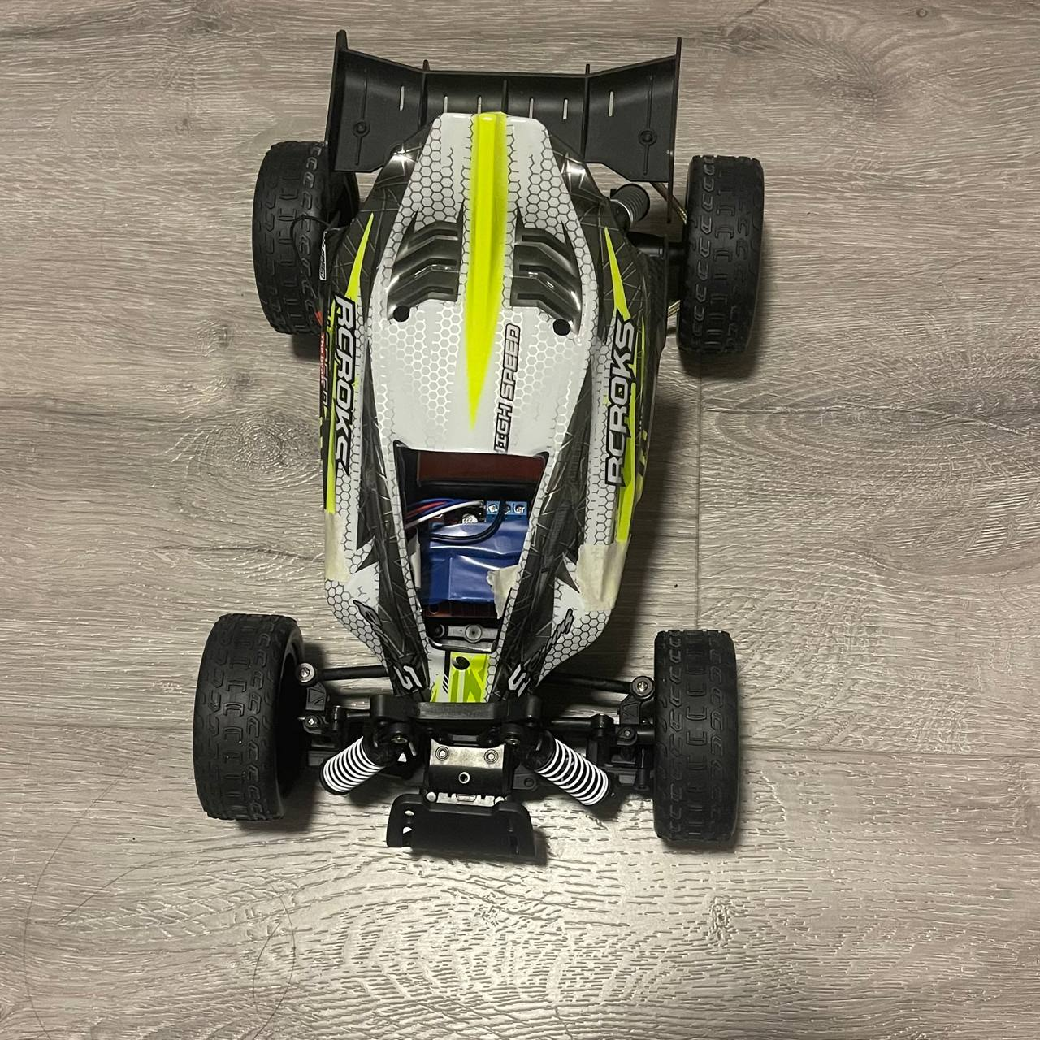
PiDriver – Visibility

Slide 14
PiDriver – Future Developments
Incorporating additional sensors to detect obstacles and improve safety
Implementing machine learning algorithms for autonomous control
Improving video streaming quality and reducing latency
Creating a mobile app for remote control
Adding features such as GPS tracking and voice control
The project's adaptability allows for continuous upgrades and improvements, making it an exciting and dynamic project.

Slide 15
PiDriver - Contact Information
Abdumalik Shamurov
Email: ashamurov@myseneca.ca
Cell: 647-687-9588

Slide 16
References
https://www.raspberrypi.com/products/raspberry-pi-3-model-b/
https://flask.palletsprojects.com/en/2.2.x/config/
https://learn.sparkfun.com/tutorials/raspberry-gpio/python-rpigpio-api
https://www.amazon.ca/dp/B00IVHQ0KI?psc=1&ref=ppx_yo2ov_dt_b_product_details
https://www.amazon.ca/dp/B073RCXGQS?ref=ppx_yo2ov_dt_b_product_details&th=1
https://www.amazon.ca/dp/B09WQZVKPK?psc=1&ref=ppx_yo2ov_dt_b_product_details
https://www.amazon.ca/dp/B01KBTNHS6?psc=1&ref=ppx_yo2ov_dt_b_product_details
https://www.amazon.ca/Complete-Starter-Raspberry-Module-Heatsink/dp/B08G8S63SL/ref=sr_1_3?crid=1D5AH0XNKG9IG&keywords=raspberry+pi+3+b%2B&qid=1680923108&sprefix=raspberry+pi+3+b%2Caps%2C83&sr=8-3
https://developer.mozilla.org/en-US/docs/Web/API/Gamepad_API/Using_the_Gamepad_API
https://maker.pro/raspberry-pi/tutorial/how-to-control-a-dc-motor-with-an-l298-controller-and-raspberry-pi
http://www.modularcircuits.com/blog/articles/h-bridge-secrets/h-bridges-the-basics/

